Slide 1
Embedded Software Design

Slide 2
Reminders
Quiz due Sunday by midnight
Assembly, NIOSII, and Embedded SW
No demo this week on Friday – Class Cancelled

Slide 3
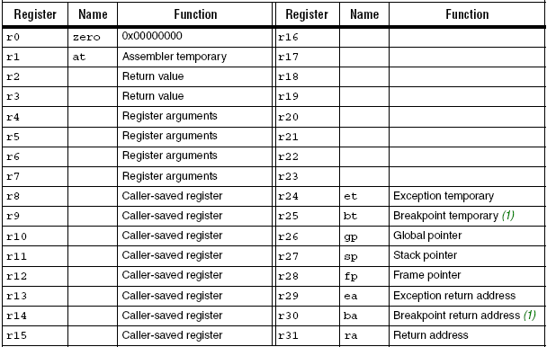
Follow Up
Can we use the name of the register when executing instructions?
Yes! Replace r0 reference with the word zero
Step through assembly, works with no issues

Slide 4

Follow Up
How do we work with IMMED values larger than 16 bits?
Approach 1 –
Register instructions allow you to work with numbers larger than 16 bits
Create a variable with 32 bit number
Add that constant and r0 and store in another register
Now you may use 32 bit number for functions
Approach 2:
Use NIOSII macro instructions
Could also be done manually
Easy with binary and hex numbers

Slide 5
Two Types of SW Development
Desktop Software Development
Written and debugged on the same machine as target
OS loads programs when program runs
Address resolution occurs when program is loaded
Loader is part of OS
Memory is usually not major concern
Embedded Software Development
Written and debugged on different machine as target
Cross-compiler run on host (development machine)
Downloaded to target for hardware/software integration

Slide 6
Embedded Software Development
Build creates an Executable & Linkable Format File (ELF)
Contains: Boot code, Application, RTOS (optional)
Downloaded to board to run on processor
Designer manages address map of peripherals
Designer manages location of application in memory
Amount of memory depends on
Amount required for instructions
Amount required for data
Amount you can afford in terms of $$$, power & board space

Slide 7
Embedded Software Development
Embedded SW Design Challenges
Software designed for specific function & target
Software tightly coupled with hardware design
Hard to debug if hardware is not available
Hard to debug real-time I/O
Real-time response
Requires deterministic response
May require code optimization
RTOS
Reliability
Failures are typically not tolerated
Ex. Launching Word vs. Pushing a brake pedal

Slide 8
Embedded Application Stack

Slide 9
Application Stack w/RTOS

Slide 10
Device Drivers
Software developed to interact with hardware
Written for specific hardware and operating system
OS or application software interacts transparently with HW
Provide a level of abstraction by hiding details of HW
Converts application function calls into device specific calls
Allows hardware to change w/o effecting OS or application
Ex: swap out PC video card ➔ load new drivers
Writing device drivers requires specific hardware knowledge
Bugs tend to be serious because drivers run at privileged level
Application Program Interface API
Defines function call OS or application uses for lower level drivers

Slide 11
Hardware Abstraction Layer (HAL)
Nios II
The HAL provides a simple device driver interface for programs to connect to the underlying hardware
The HAL application program interface (API) is integrated with the ANSI C standard library
The HAL API allows access to devices and files using familiar C library functions
Printf(), fopen(), fwrite(), etc.
The HAL serves as a device driver package for NIOS II processor systems
Provides a consistent programming interface to the peripherals in a NIOS II system

Slide 12
HAL Architecture and Services
Nios II
Integration with the newlib ANSI C standard library
Provides the familiar C standard library functions
Device drivers
Provides access to each device in the system
The HAL API
Provides a consistent, standard interface to HAL services, such as on-chip peripheral access, interrupt handling and alarm facilities
System initialization
Performs initialization tasks for the processor and the runtime environment before main()
Device initialization
Initializes each device in the system before main() runs

Slide 13
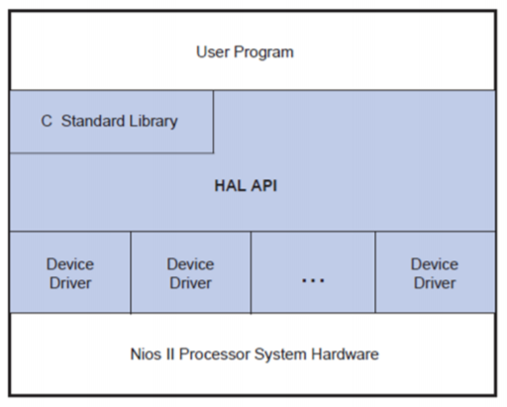
Layers of NIOS II HAL-Based System

Slide 14
Levels of Languages
Programming languages
Machine Code
Basic language of computers ➔ ones and zeros
Machine dependant
Hard to read, program and maintain
Assembly Language
Uses mnemonics to improve readability
Representation of machine language
Used for code where size or speed is critical
Used to access special commands or hardware
Disadvantages
Longer programs than high level languages
Machine dependent code

Slide 15
Levels of Languages
Programming languages
High level Languages
Hardware independent
More human readable
Ex: C, Pascal, etc
Very High Level Languages
Hardware independent
More human readable
Object-oriented languages
Ex: C++, Java

Slide 16
Language Level Summary
 | Language | Description
1st Generation | Machine Code | Binary (0,1) and hardware dependent
2nd Generation | Assembly language | Hardware dependent but at a more readable format using mnemonics
3rd Generation | High-Level Languages | Higher level language more like English words that makes code more readable. Code is also more portable between platforms because it is not machine dependent.
4th Generation | Very High Level Languages | The next still in evolution of high level languages where code is objects are used.
5th Generation | Natural Languages | Languages that are very similar normal conversation. Used in artificial intelligent. Still in development.

Slide 17
Tools and Resultant Files
Compiler
Tool that translates high-level languages into Assembly
Assembler
Tool that translates ASM into machine language
Reads ASM to produce object files
Object files
Contains machine instructions & other book keeping info
Can be executed if it does NOT contain unresolved references to other object files or libraries
Every object file has sections
Sections organize code by common characteristics
Sections may or may not have any contents
Empty sections have memory reserved

Slide 18
Tools and Resultant Files
Linker
Tool that combines object files into single executable
Searches program libraries to find library routines
Determines the memory locations that code will occupy and adjust absolute references
Resolve all references (labels) among object files
Linking is controlled by linker script file
Defines how input files are mapped to output files
Controls where code sections are mapped to memory

Slide 19
Linker Tool
Linking libraries
Static linking
Libraries routines are linked into executable
Executables become large
Executable can’t access libraries updates w/o being recompiled
Dynamic Linking (DLL)
Library linked and loaded at run-time
Avoids linking entire library into executable
Executable can link in new library updates at run-time
Requires extra space for DLL but smaller than entire library
Small run-time penalty to load library dynamically

Slide 20
Software Design Flow Example
Executable and Linking Format File (*.elf)
Created when you build Nios II program
Runs on Nios II processor

Slide 21
Object File
Typical Object Sections
.text
Only executable code goes here
.rodata and .sdata2
Contains read-only data
Ex: Print strings and constants
.data and .sdata
Contains read/write data
.bss and .sbss
Uninitialized data (variables)

Slide 22
Object Files
Nios II
Dumping Object Files
Object dump will show memory address of various sections
Critical information for debugging embedded software
Must launch Nios II command shell
Launch from Program → Intel_FPGA → NiosII
Change directory to location of executable file
To dump help
nios2-elf-objdump
Dump header locations
nios2-elf-objdump -h
Dump code source
nios2-elf-objdump –S

Slide 23
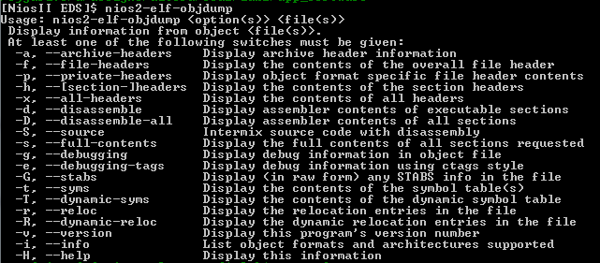
Object Files
Nios II
nios2-elf-objdump
Sample help screen

Slide 24
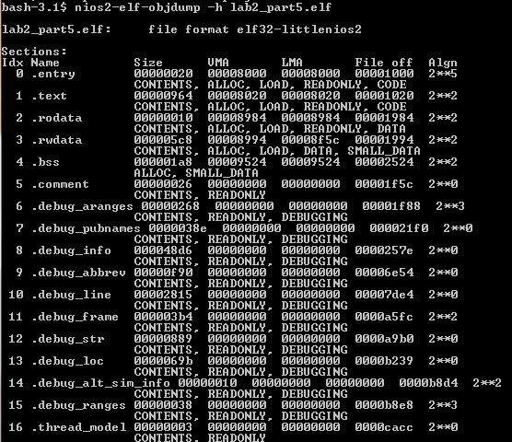
Dumping Object Files
Load Memory Address
Nios II
Size of section in bytes
Virtual Memory Address

Slide 25
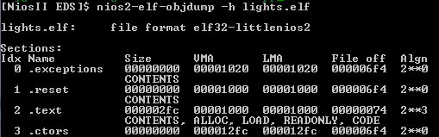
Object File
Nios II
Dumping Object Files
The LMA and VMA may differ
ROM based system
Loading a data section into ROM and then copying it into RAM
LMA would be associated with the ROM
VMA associated with the RAM

Slide 26
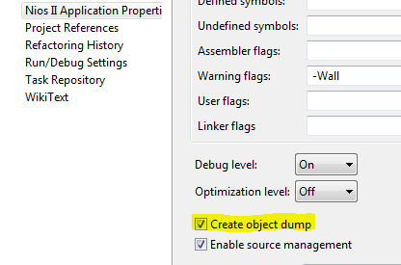
Object File
Nios II
Dumping Object Files
Nios II SBTs generate *.objdump file
Text file located in your Nios II application directory
Provides information about your .elf such as
Information about the memory sections and their layout,
Addresses of functions, w/ C code interleaved w/ assembly
To enable right-click your application project and click Properties
Click Nios II
Application Properties
On Properties page
turn on Create object dump.

Slide 27
Map File
Nios II
Nios II SBT generate *.map file
Text file located in your Nios II application directory
Provides information including which object files are included in the executable, the path to each object file, where objects and symbols are located in memory, and how the common symbols are allocated
Good for finding variables in memory and peeking them for debug

Slide 28
Embedded Software Considerations
Compiler Optimizations
Procedure Inlining
Replacing functions call with actual code to avoid overhead of call
Loop Unrolling
Replicating loop body & reducing the loop counter
Must understand loop behavior
Reduces loop overhead (test and jump)
Example:
for i = 1 to 10
<do some work>
after loop unrolling may become
for i = 1 to 5
<do some work>
<do some work>

Slide 29
Embedded Software Considerations
Compiler Optimizations
Common sub-expression elimination
Finding multiple instances of same expression and replace 2nd reference with reference to first
Example:
A = B * C + G
E = B * C + M
after sub-expression elimination become
X = B * C
A = X + G
E = X + M
Strength reduction
Replacing complex operations with simpler operations
Machine dependent
Ex: Replacing multiply with a shift

Slide 30
Embedded Software Considerations
Compiler Optimizations
Dead Store Eliminations
Removing stored values that are not used
Eliminates overhead of doing store
Dead Code Eliminations
Removing Code that does not effect final result
Code Motion
Removing code from loops that doesn’t effect the loop
Ex:
Loop on I
A=B+C // can be moved above loop
D=A+X[i]
End loop

Slide 31
Embedded Software Considerations
Compiler Optimizations
Constant propagation
Replace all instances of a variable that is assigned a constant with constant
Ex:
X = 3; x = 3;
Y = X + 4 Y = 7;
Copy propagation
Copy variable value to avoid re-loading value
Ex:
Y = X;
Z = Y + 4 Z = X + 4;
Pipeline Scheduling
Reordering instructions to improve pipeline scheduling
➔ Becomes ➔
➔ Becomes ➔

Slide 32
Embedded Software Considerations
When do you not want optimized code?
When debugging code
Not concern with speed of program
Want to be able to trace logical flow of program
Similar to functional simulation in VHDL
Conflicts with embedded design feature
Real-time response may require optimization for performance
Problems with optimized code
Code may work with no optimization but fails with compiler optimization is enabled
Most common problem is missing volatile type qualifier

Slide 33
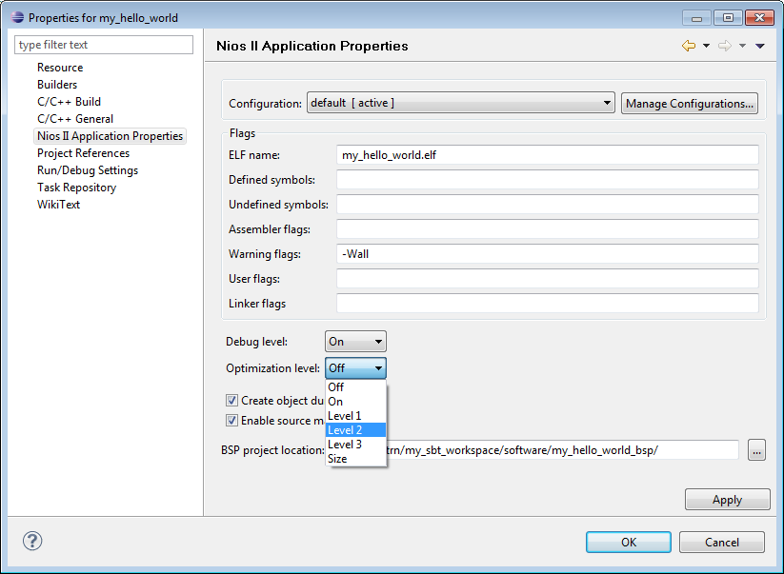
Embedded Software Considerations
Compiler Optimizations
gcc Optimization Levels:
Off (-O0)
-Fast compile
On and Level 1 (-O -O1)
-Speed and size optimization
Level 2 (-O2)
-Full optimization without speed-space tradeoff
Level 3 (-O3)
-Full optimization, larger size
Size (-Os)
- Optimize space usage
Notes:
Level 3: O3 uses agrees inlining of subprograms and makes the program much larger

Slide 34
Embedded Software Considerations
Options for Code Footprint Reduction
Enable Compiler size optimizations
-Os or -03
Use reduce device driver
Use ANSI C library
Remove clean exit
If code runs forever then you don’t need clean exit
Disable C++ support
Enable lightweight device driver API
Only stdin, stdout and stderrr file descriptor supported
-Os or –O3

Slide 35
Embedded Software Considerations
Good Practices
Use volatile for registers and user input accesses
Allocate memory in advance
Good to bound memory required for application
Define fixed arrays to hold data
Avoid using malloc to allocate memory
Control pointers offsets
Check if offsets are in bounds
Arrays help perform checks
Place constants on left when performing check
Ex:
if (MAX_VALUE == variable)
Instead of
if (variable == MAX_VALUE)

